Slide 1

MICRONUTRIENT IMBALANCE PART 2
WATER SOLUBLE VITAMINS

Slide 2

B –VITAMINS
Vitamin B1- Thiamine
Vitamin B2- Riboflavin
Vitamin B3- Niacin
Vitamin B5- Pantothenic Acid
Vitamin B 6 - Pyridoxine
Vitamin B9- Folic acid
Vitamin B 12- Cyanocobalamin

Slide 3
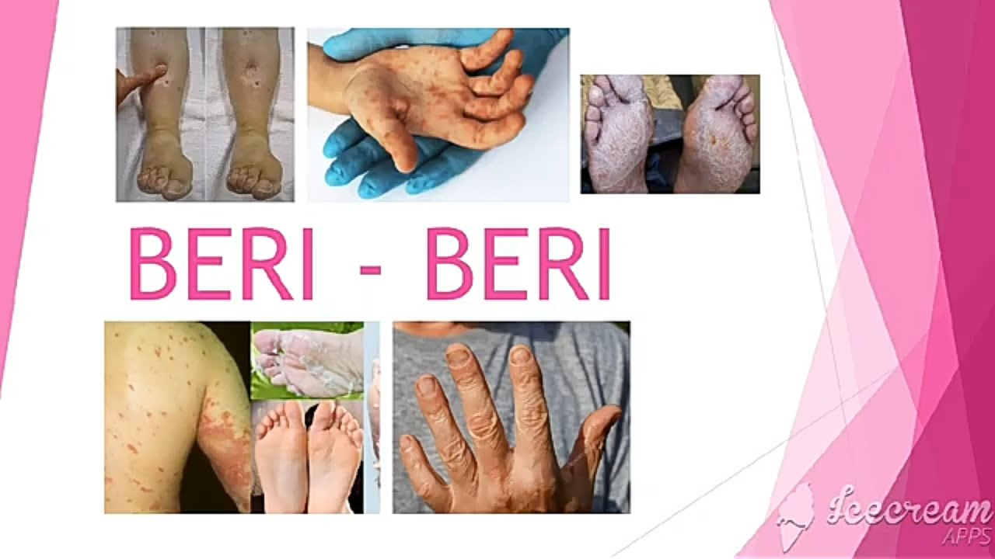
Vitamin B1 (Thiamine)- Deficiency
Gastro Intestinal Beriberi
Abdominal Pain
Nausea
Vomiting
Wet Beri beri
Dry Beriberi
Difficulty in walking
Tingling or loss of sensation (numbness) in hands and feet
Loss of tendon reflexes
Loss of muscle function or paralysis of the lower legs
Mental confusion/speech difficulties

Slide 4
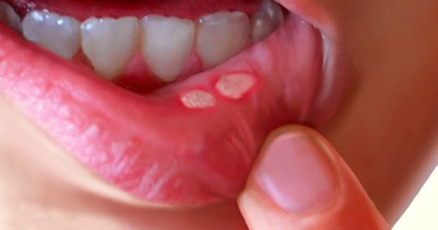
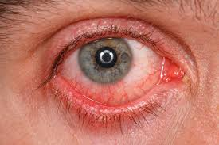
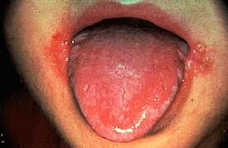
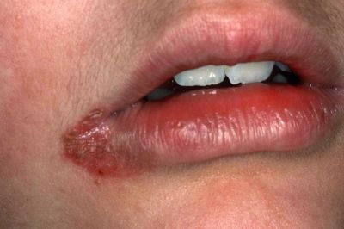
Vitamin B2 (Riboflavin) - Deficiency
Ariboflavinosis
Skin disorders
Hyperemia (excess blood) and edema of the mouth and throat
Angular stomatitis (lesions at the corners of the mouth)
Cheilosis (swollen, cracked lips)
Hair loss, reproductive problems
Sore throat
Itchy and red eyes
Degeneration of the liver and nervous system
Red eyes
Angular stomatitis
Cheilosis

Slide 5

Find your answer
1. Is it true that garlic oil increases vitamin B₁ absorption?
2. Can you get B vitamins from vegetables?

Slide 6
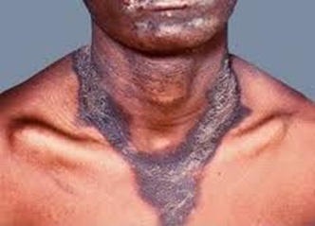
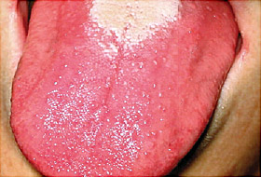
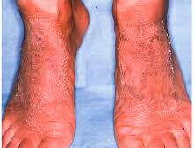
Vitamin B3 (Niacin) - Deficiency
Pellagra
Thick, scaly pigmented rash on skin exposed to sunlight
Swollen mouth and bright red tongue
Vomiting and diarrhoea
Headache
Apathy
Fatigue
Depression
Disorientation
Memory loss
Pigmented rash
Bright red tongue
Scaly Skin

Slide 7
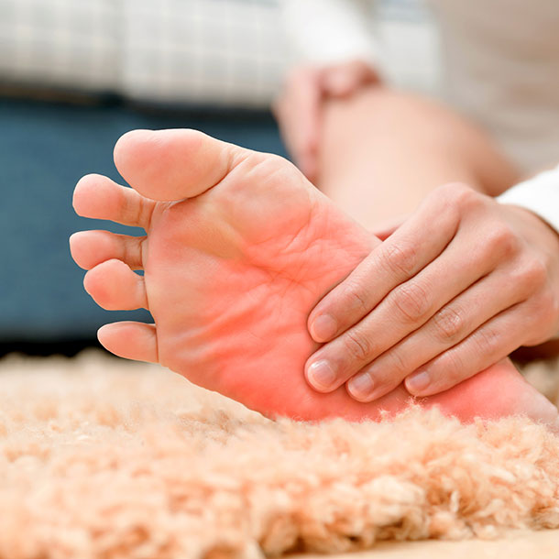
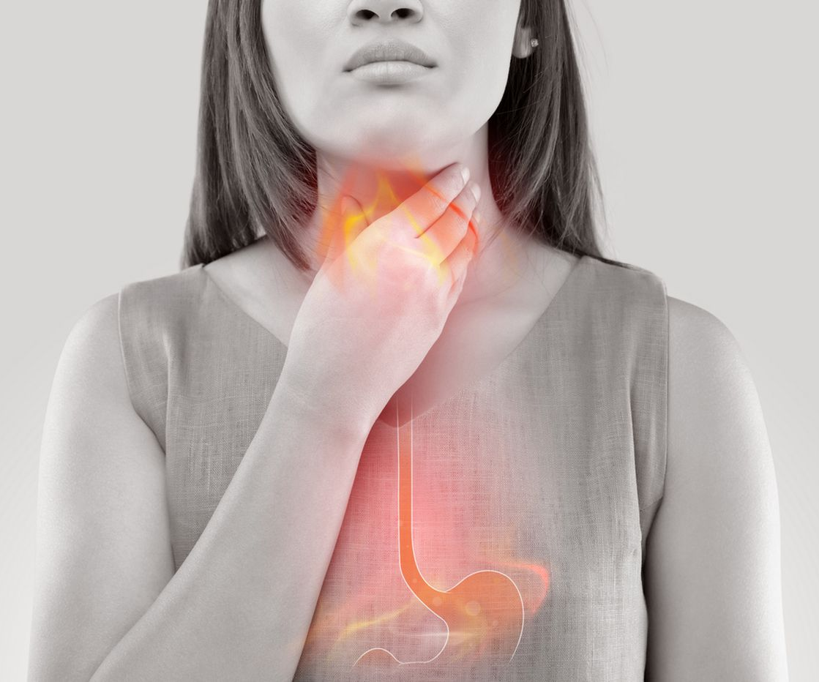
Vitamin B5 (Pantothenic Acid) - Deficiency
Numbness and burning of the hands and feet
Headache
Extreme tiredness
Irritability
Restlessness
Sleeping problems
Stomach pain
Heartburn
Diarrhea, nausea, vomiting, and loss of appetite.
Burning of the hands and feet
Heartburn

Slide 8
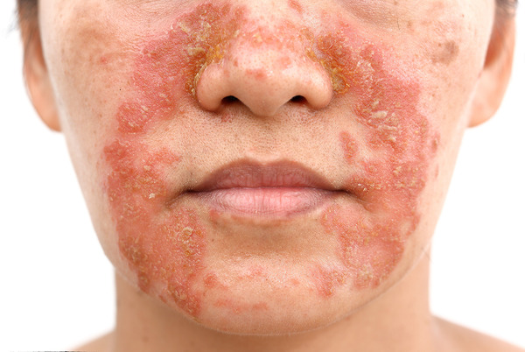
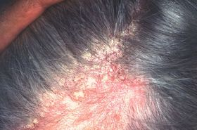
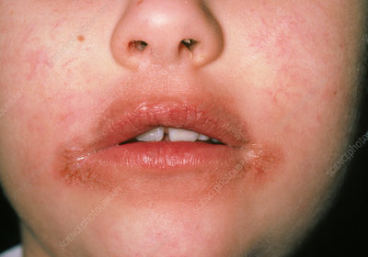
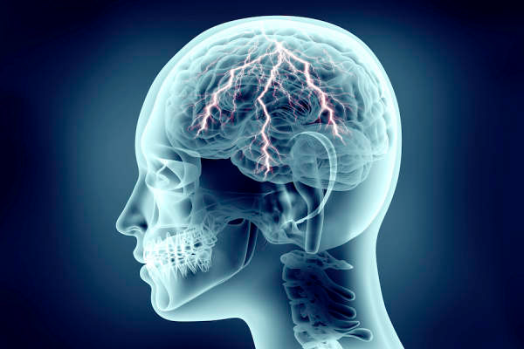
Vitamin B6 (Pyridoxine) - Deficiency
Dermatitis
Peripheral neuropathy
Seborrheic dermatitis
Glossitis and cheilosis
In adults, depression, confusion, and seizures.
Dermatitis
Seborrheic dermatitis
Seizures
Cheilosis

Slide 9
Find your answer
1. Niacin is involved in:
DNA repair.
Production of steroid hormones.
Converting carbohydrates into energy.
All of the above.
2. Is it better to take B complex or individual B vitamins?

Slide 10

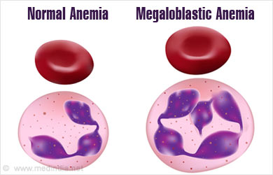
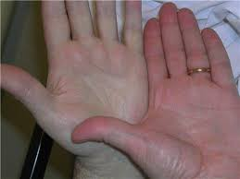
Vitamin B9 (Folic Acid) - Deficiency
Megaloblastic Anemia
Persistent fatigue.
Weakness.
Lethargy.
Pale skin.
Shortness of breath.
Irritability.
Lethargy
Megaloblastic Anemia
Pale skin

Slide 11


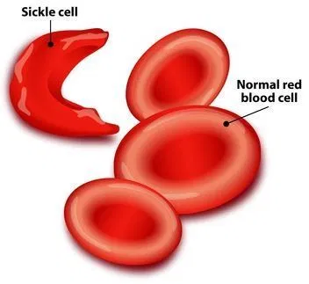
Vitamin B12 (Cyanocobalamin) - Deficiency
Heart palpitations
Pernicious Anemia
Weakness, tiredness, or light headedness.
Heart palpitations and shortness of breath.
Pale skin.
A smooth tongue.
Constipation, diarrhea, loss of appetite, or gas.
Nerve problems like numbness or tingling, muscle weakness, and problems walking.
Vision loss.
Shortness of breath
Pernicious Anemia

Slide 12

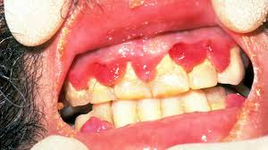
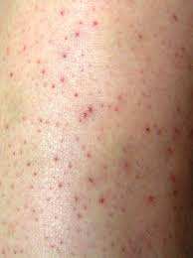
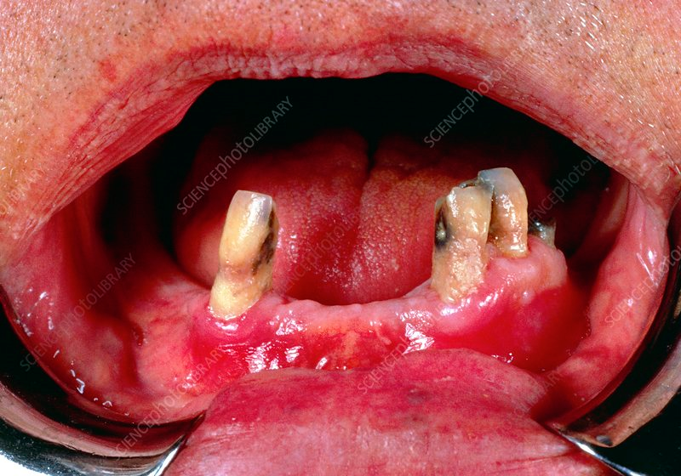
Vitamin C (Ascorbic Acid) - Deficiency
.
SCURVY
Tiredness and weakness.
Muscle and joint pains.
Easy bruising.
Red-blue bruises on your skin.
Poor healing of wounds.
Tooth loss
Dry skin.
Splitting hair.
Swelling and discoloration of your gums.
Sudden and unexpected bleeding from your gums.
Nose bleeds.
Bleeding Nose
Bleeding gums
Loose teeth and weak gums
Red Bruises

Slide 13
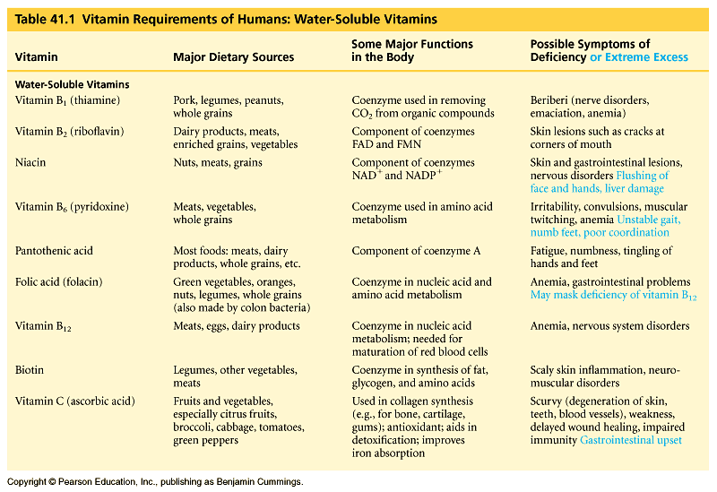
Overview of Water Soluble Deficiency

Slide 14
Find your answer
In the U.S., who is most likely to develop scurvy (vitamin C deficiency)?
A pregnant woman
A malnourished child
A person with the eating disorder anorexia nervosa
A long-time alcoholic
A person who does not eat meat, fish, eggs, or dairy products (vegan)
If I don’t smoke myself, but am around heavy smokers, are there any vitamins I should take more of?
When should folate be taken?

Slide 15
REFERENCE BOOKS
Food Science- Srilakshmi, Prosper Montague Publishing Group Ltd., Hamlyn, London. 2003.
Food & Nutrition- Swaminathan, The Bangalore Printing & publishing co ltd., Vol I, Second Edition, Bangalore (1995).
An Introduction to Lifestyle Management: Facilitator’s Handbook, Dr.Anja Morris-Paxton, 2019
DEVELOPED RESOURCE MATERIALS
Water Soluble Vitamins Developed PDF attached in Ample course content
LOCAL VIDEO DEVELOPED:
https://youtu.be/tMsrbSaBSFc - Video link is available in Ample course content

Slide 16

EAT THE BEST AND LEAVE THE REST

